Slide 1

DAYALEKTOR
Belchez, Maica L. Carpio, Aira Joyce A. Gardon, Jana Marie G. Haboc, Florence Gail G.

Slide 2
Overview
Lean Canvas
Business Startup Cost
Revenue Projection
Online Surveys

Slide 3
Lean Canvas

Slide 4
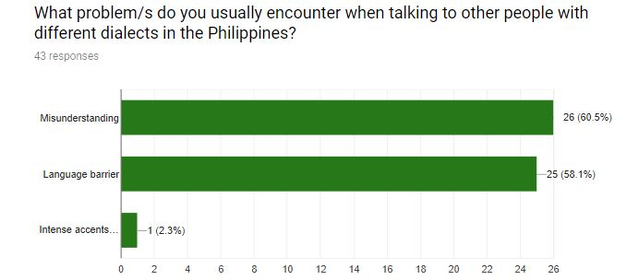

Slide 5
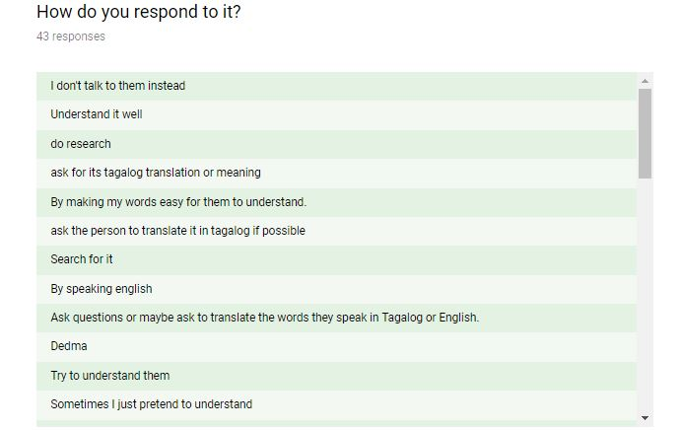
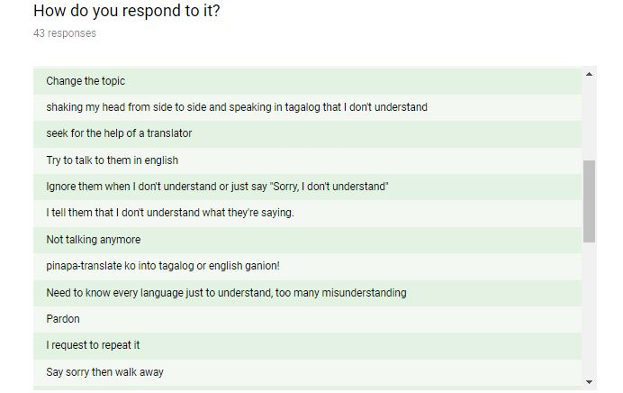
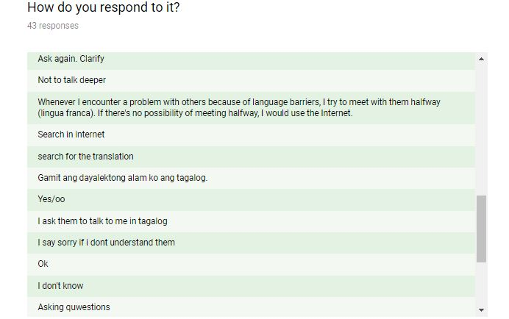
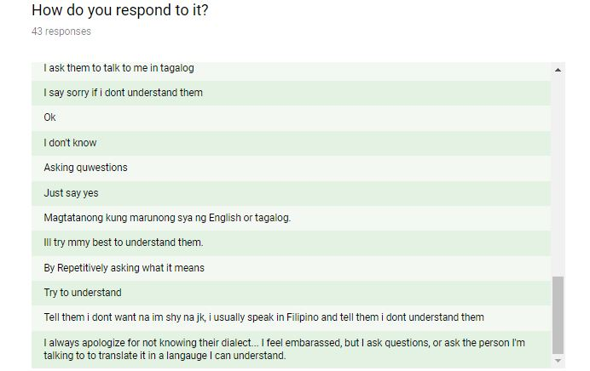

Slide 6


Problems

Slide 7



Solutions

Slide 8
Features
Philippine Dialects Translator
Offline Vocabulary Library
Word of the Day
Delegated Correction

Slide 9
Situational Benefits
Translate Philippine dialects into English or Filipino languages and vice versa
Improve vocabulary and check pronunciation
Auto-respond to any set of phrases
Direct voice delivery as a better experience
The app will pronounce the word
Ask someone, in the forum, for correction

Slide 10
Marketing Message
“NEVER GET LOST IN TRANSLATION”

Slide 11
Channels
Social Networks
Blog
Advertisement
Email
Website

Slide 12
Customer Segments
Filipinos/Foreigners
Both female and male
18 and above
Tourists and Travelers

Slide 13
Cost Structure
Mobile Development
Marketing
Advertising
Salaries
Utilities

Slide 14
Revenue Streams
Stakeholders
Paid Customers
Development Fees

Slide 15
Business Startup Cost

Slide 16
Personnel | Salary (monthly) | Duration (month) | Total
Project Manager | ₱36,667 | 18 | ₱660,006
Business Analyst | ₱18,841 | 6 | ₱113,046
Mobile Applications Developer (Android) | ₱26,667 | 18 | ₱480,006
Database Developer | ₱15,501 | 9 | ₱139,509
Quality Assurance Analyst | ₱12,112 | 3 | ₱36,336
 |  |  | ₱1,428,903
Software | Price | Duration (month) | Total
Android Studio | Free | 18 | -
Firebase | Free | 18 | -
SQLite | Free | 18 | -
 |  |  | -
Facilities/Utilities/Equipment/Furniture | Price | Duration (month) | Total
Working Space | ₱9,000 | 18 | ₱162,000
Computers | ₱60,000 | 18 | ₱60,000
Laptops (for backup) | ₱30,000 | 18 | ₱30,000
Tables (4) | ₱2,185 | 18 | ₱8,740
Chairs (4) | ₱980 | 18 | ₱3,920
Aircon | ₱2,413 | 18 | ₱2,413
Internet Access | ₱1,797.05 | 18 | ₱32,346.90
Electricity, Water | ₱2,568.21 | 18 | ₱46,227.78
 |  |  | ₱345,647.68
Contingency Cost | ₱53,236.52
Overall Total | ₱1,774,550.68

Slide 17
Revenue Projection

Slide 18
GOAL
₱1,774,550.68 in sales within 548 days
That’s 33 downloads at ₱100 each
The conversion rate is 2.35%, there will be 1,378 users a day

Slide 19
Online Surveys

Slide 20
Part 1 – Pain Points

Slide 21
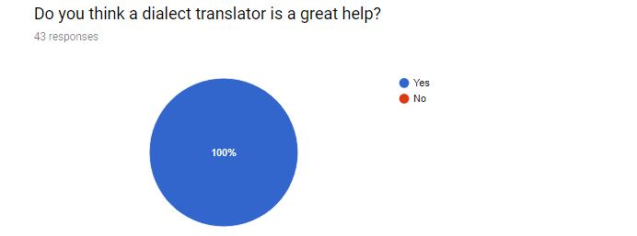
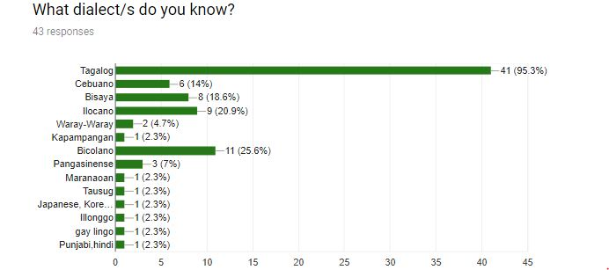

Slide 22
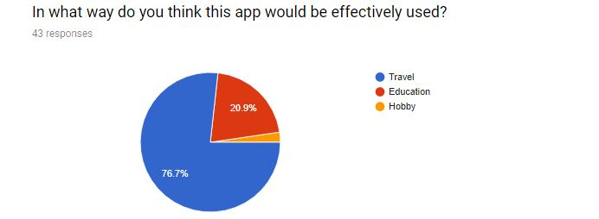
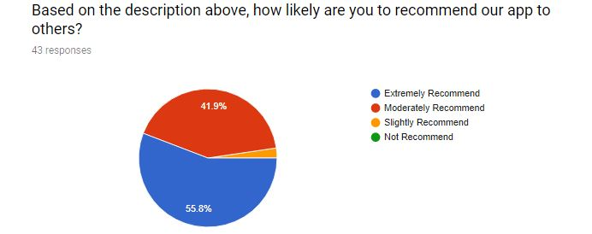

Slide 23
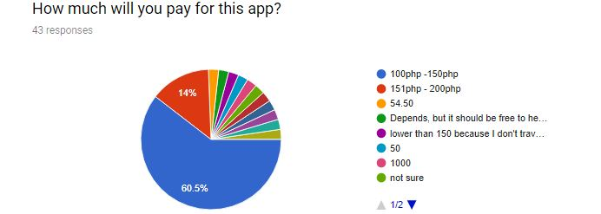
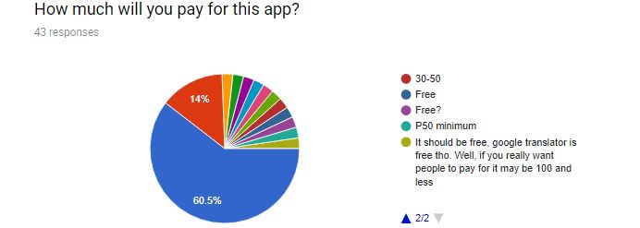

Slide 24
Part 2 – Features

Slide 25
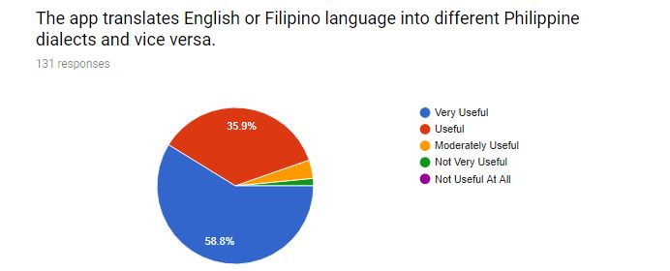
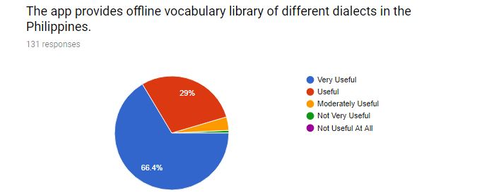

Slide 26
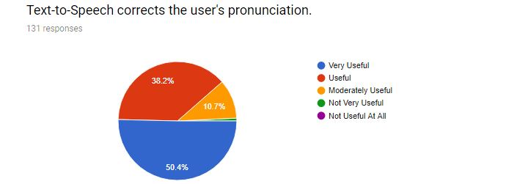
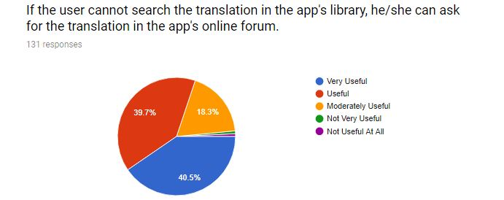

Slide 27
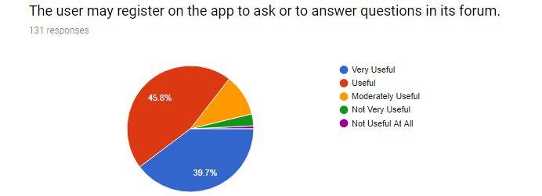
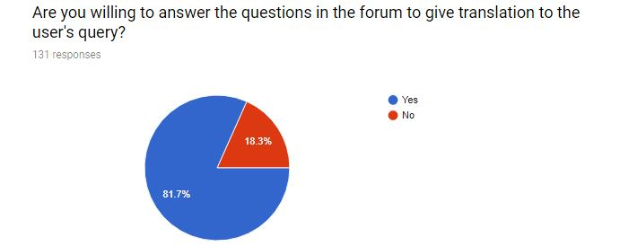

Slide 28
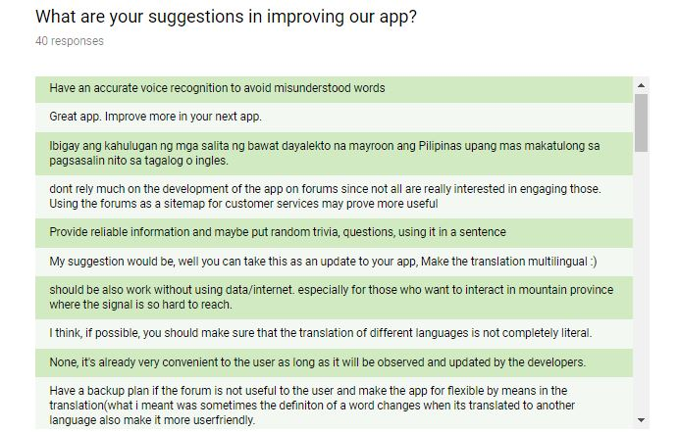
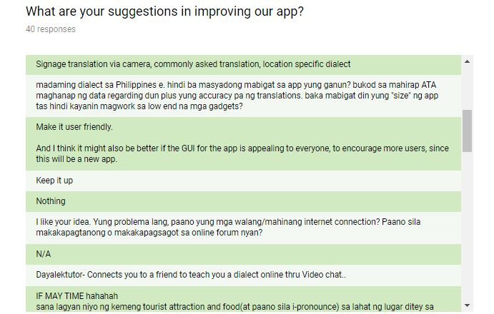
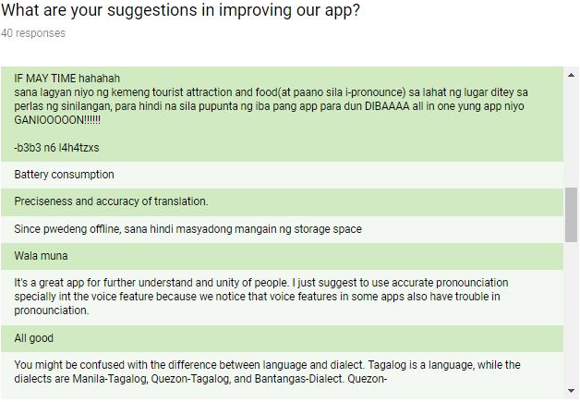

Slide 29
